Slide 1
Remedial Measures,
Brown-Forsythe test,
F test
Dr. Frank Wood
TexPoint fonts used in EMF.
Read the TexPoint manual before you delete this box.: AAAAAAAAA

Slide 2
Remedial Measures
How do we know that the regression function is a good explainer of the observed data?
  Plotting
  Tests
What if it is not? What can we do about it?
  Transformation of variables (next lecture)

Slide 3
Graphical Diagnostics for the Predictor Variable
Dot Plot
  Useful for visualizing distribution of inputs
Sequence Plot
  Useful for visualizing dependencies between error terms
Box Plot
  Useful for visualizing distribution of inputs
Toluca manufacturing example again: production time vs. lot size.

Slide 4
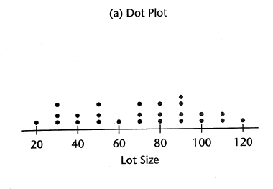
Dot Plot
How many observations per input value?
Range of inputs?

Slide 5
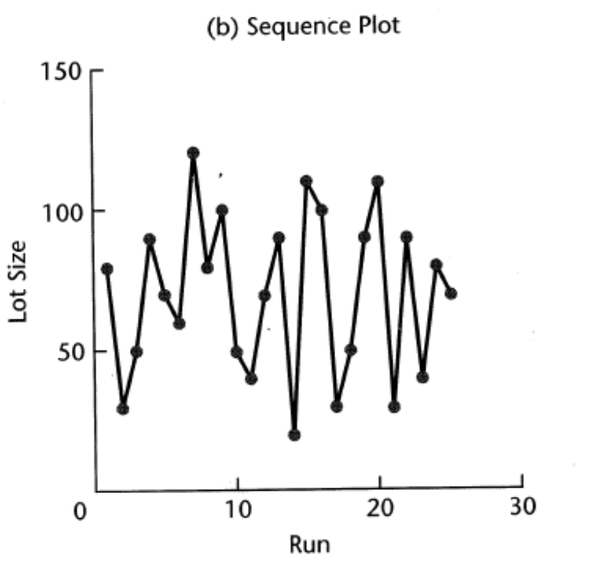
Sequence Plot
If observations are made over time, is there a correlation between input and position in observation sequence?

Slide 6
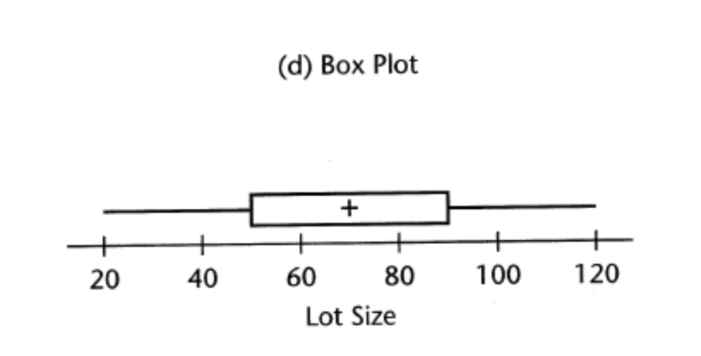
Box Plot
Shows
  Median
  1st and 3rd quartiles
  Maximum and minimum

Slide 7
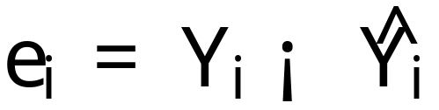
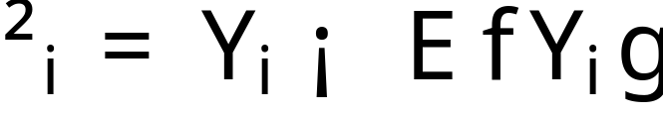
Residuals
Remember, the definition of residual:
And the difference between that and the unknown true error
In a normal regression model the ²_{i}’s are assumed to be iid N(0,¾²) random variables. The observed residuals e_{i} should reflect these properties.

Slide 8
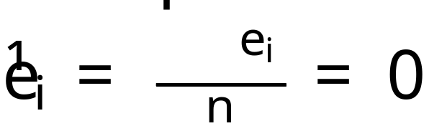
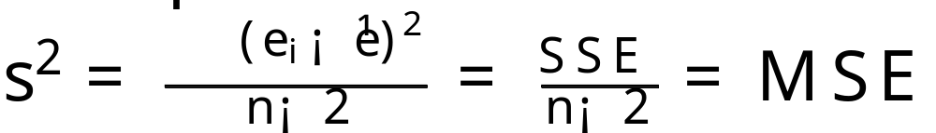
Remember: residual properties
Mean
Variance

Slide 9

Nonindependence of Residuals
The residuals e_{i} are not independent random variables
  The fitted values are based on the same fitted regression line.
    The residuals are subject to two constraints
      Sum of the e_{i}’s equals 0
      Sum of the products X_{i} e_{i}‘s equals 0
When the sample size is large in comparison to the number of parameters in the regression model, the dependency effect among the residuals e_{i} can reasonably safely be ignored.

Slide 10
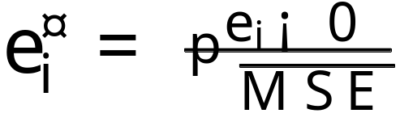
Definition: semistudentized residuals
Like usual, since the standard deviation of ²_{i} is ¾ (itself estimated by MSE^{1/2}) a natural form of standardization to consider is
This is called a semistudentized residual.

Slide 11
Departures from Model…
to be studied by residuals
  Regression function not linear
  Error terms do not have constant variance
  Error terms are not independent
  Model fits all but one or a few outlier observations
  Error terms are not normally distributed
  One or more predictor variables have been omitted from the model

Slide 12
Diagnostics for Residuals
Plot of residuals against predictor variable
Plot of absolute or squared residuals against predictor variable
Plot of residuals against fitted values
Plot of residuals against time or other sequence
Plots of residuals against omitted predictor variables
Box plot of residuals
Normal probability plot of residuals

Slide 13
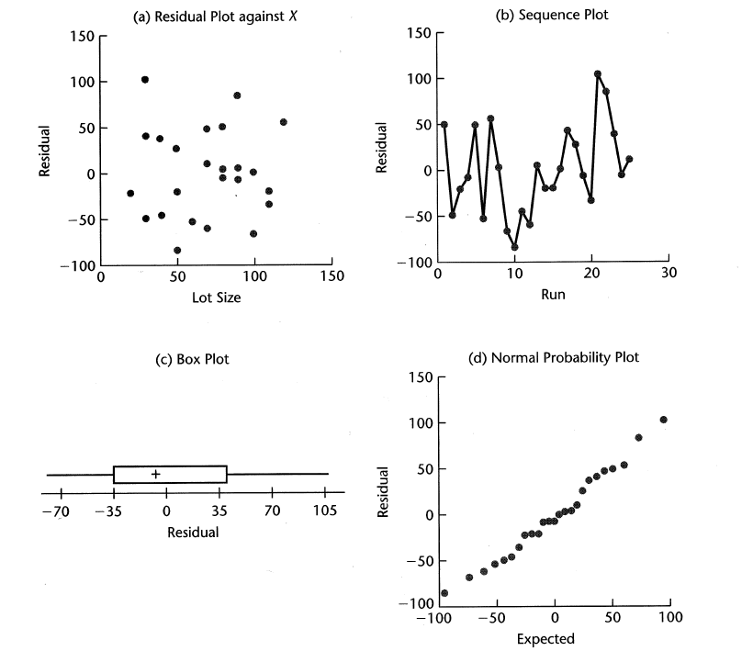
Diagnostic Residual Plots

Slide 14
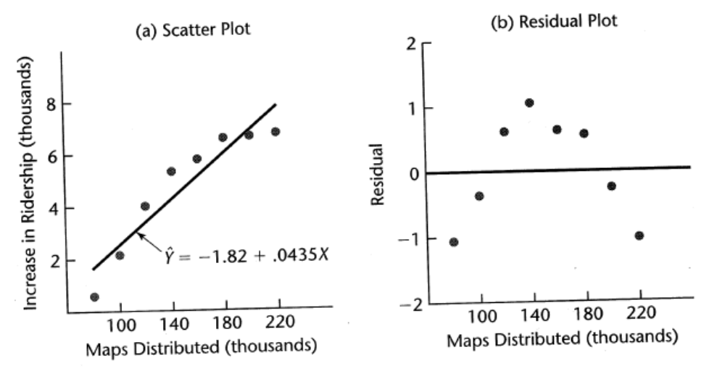
Scatter and Residual Plot

Slide 15
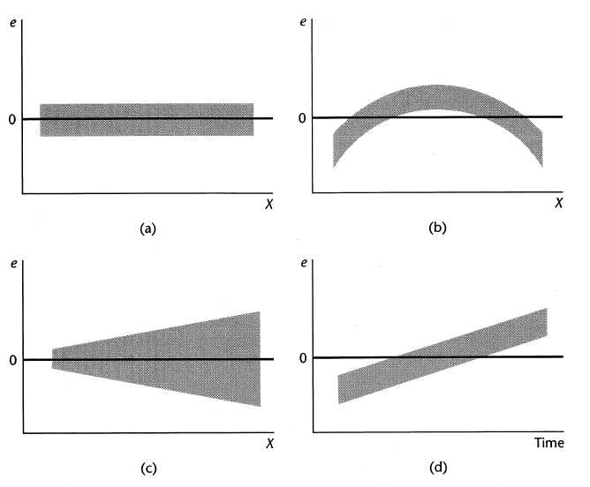
Prototype Residual Plots

Slide 16
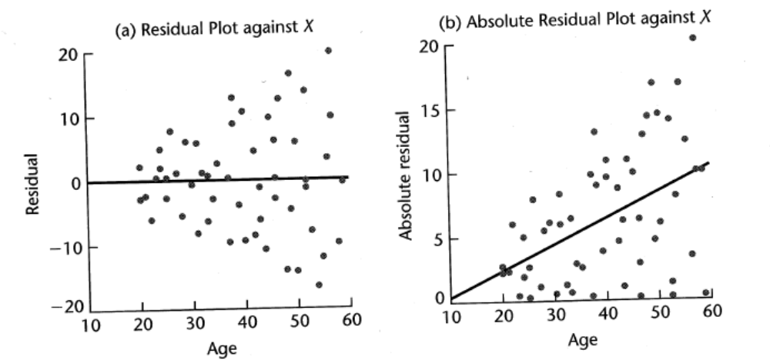
Nonconstancy of Error Variance

Slide 17
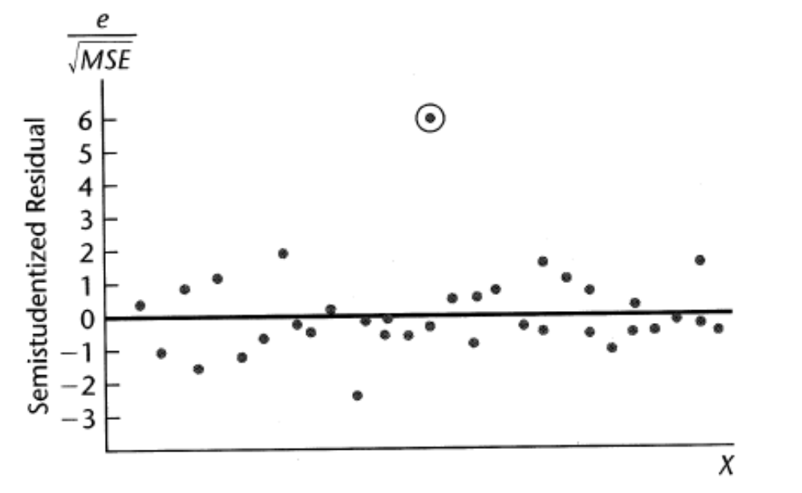
Presence of Outliers
Outliers can strongly effect the fitted values of the regression line.

Slide 18
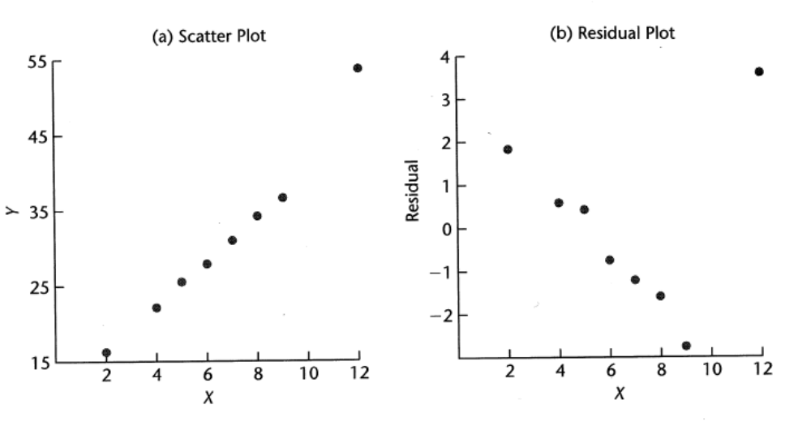
Outlier effect on residuals

Slide 19
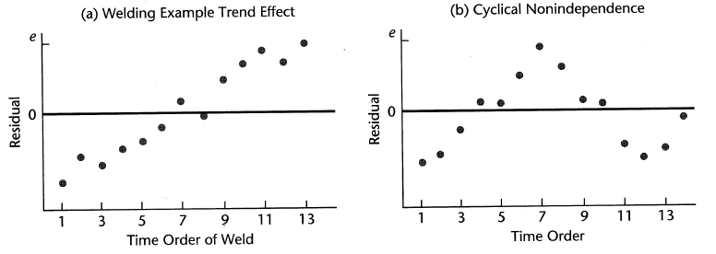
Nonindependence of Error Terms
Sequential observations

Slide 20
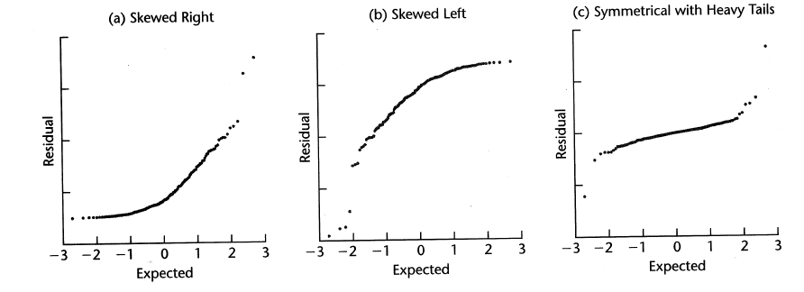
Non-normality of Error Terms
Distribution plots
Comparison of Frequencies
Normal probability plot

Slide 21
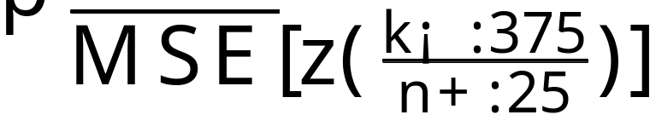
Normal probability plot
For a N(0,MSE^{1/2}) random variable, a good approximation of the expected value of the k^{th} smallest observation in a random sample of size n is
A normal probability plot consists of plotting the expected value of the k^{th} smallest observation against the observed k^{th} smallest observation

Slide 22
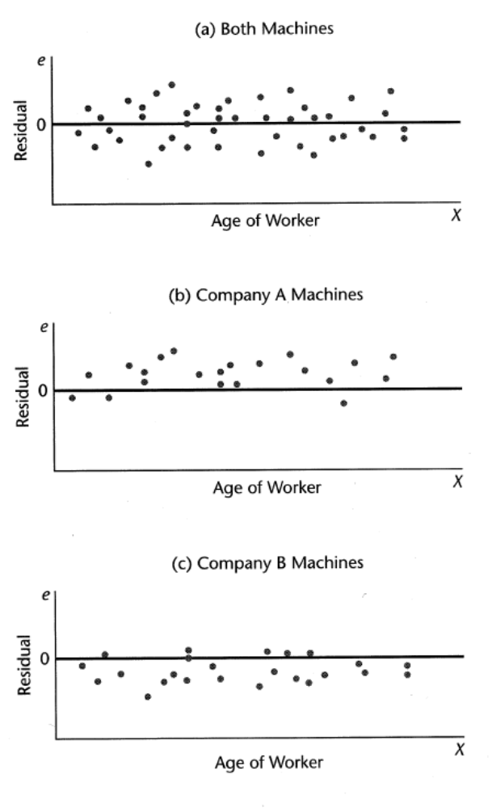
Omission of Important Predictor Variables
Example
  Qualitative variable
    Type of machine
Partitioning data can reveal dependence on omitted variable(s)
Works for quantitative variables as well
Can suggest that inclusion of other inputs is important

Slide 23
Tests Involving Residuals
Tests for randomness
Tests for constancy of variance
Tests for outliers
Tests for normality

Slide 24
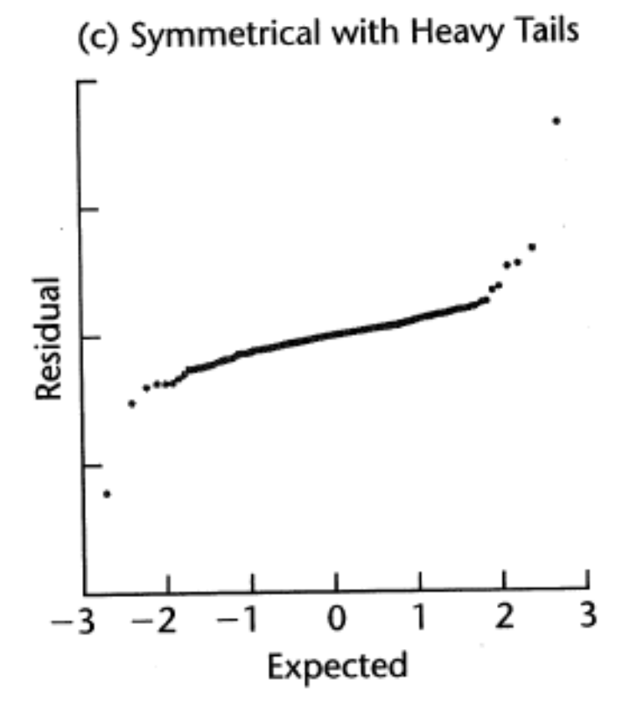
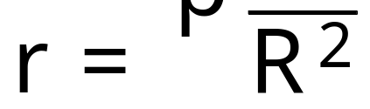
Correlation Test for Normality
Calculated the coefficient of correlation between residuals e_{i} and their expected values under normality
Tables (B.6 in the book) given critical values for the null hypothesis (normally distributed errors) holding

Slide 25
Tests for Constancy of Error Variance
Brown-Forsythe test does not depend on normality of error terms.
  The Brown-Forsythe test is applicable to simple linear regression when
    The variance of the error terms either increases or decreases with X
    Sample size is large enough to ignore dependencies between the residuals
Basically a t-test for testing whether the means of two normally distributed populations are the same

Slide 26

Brown-Forsythe Test
Divide X into X₁ (the low values of X) and X₂ (the high values of X)
Let e_{i1} be the error terms for X₁ and vice versa
Let n = n₁ + n₂
The Brown-Forsythe test uses the absolute deviations of the residuals around their group median

Slide 27
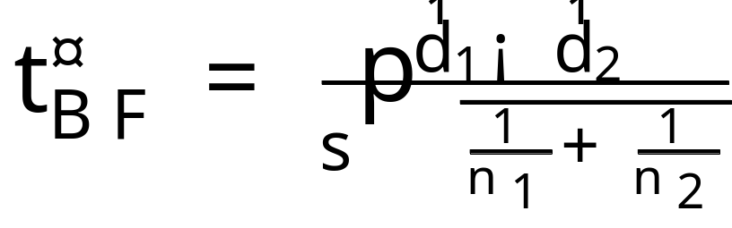
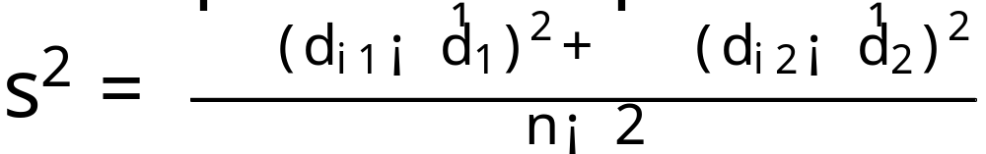
Brown-Forsythe Test
The test statistic for comparing the means of the absolute deviations of the residuals around the group medians is
where

Slide 28
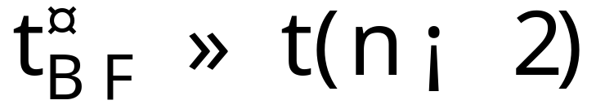
Brown-Forsythe Test
If n₁ and n₂ are not extremely small
approximately
From this confidence intervals and tests can be constructed.

Slide 29
F test for lack of fit
Formal test for determining whether a specific type of regression function adequately fits the data.
Assumptions (usual) :
  Y | X
    iid
    normally distributed
    same variance ¾²
Requires: repeat observations at one or more X levels (called replicates)

Slide 30
Example
12 similar branches of a bank offered gifts for setting up money market accounts
Minimum initial deposits were specified to qualify for the gift
Value of gift was proportional to the specified minimum deposit
Interested in: relationship between specified minimum deposit and number of new accounts opened

Slide 31
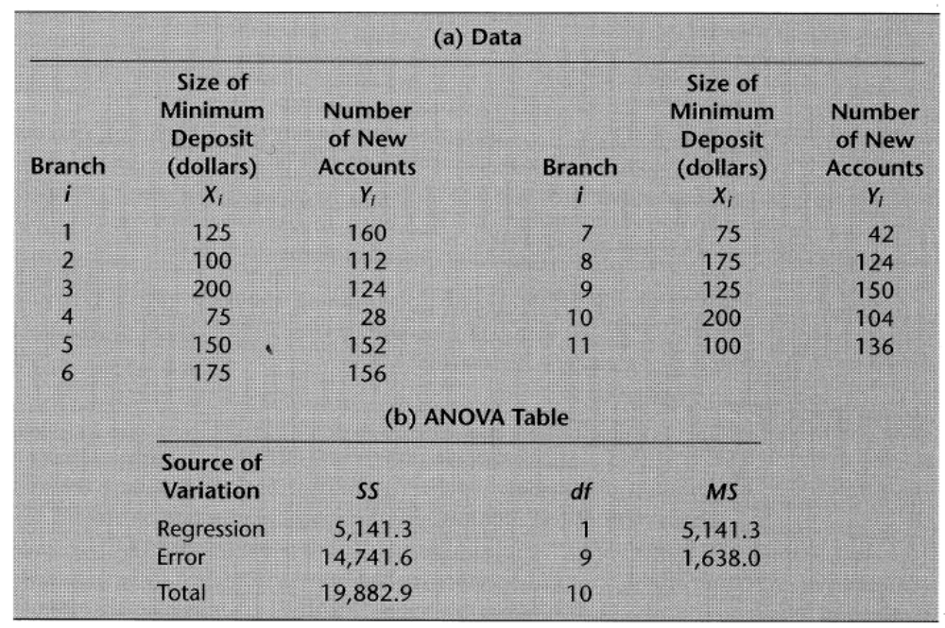
F Test Example Data and ANOVA Table

Slide 32
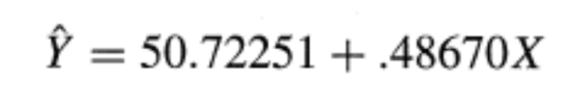
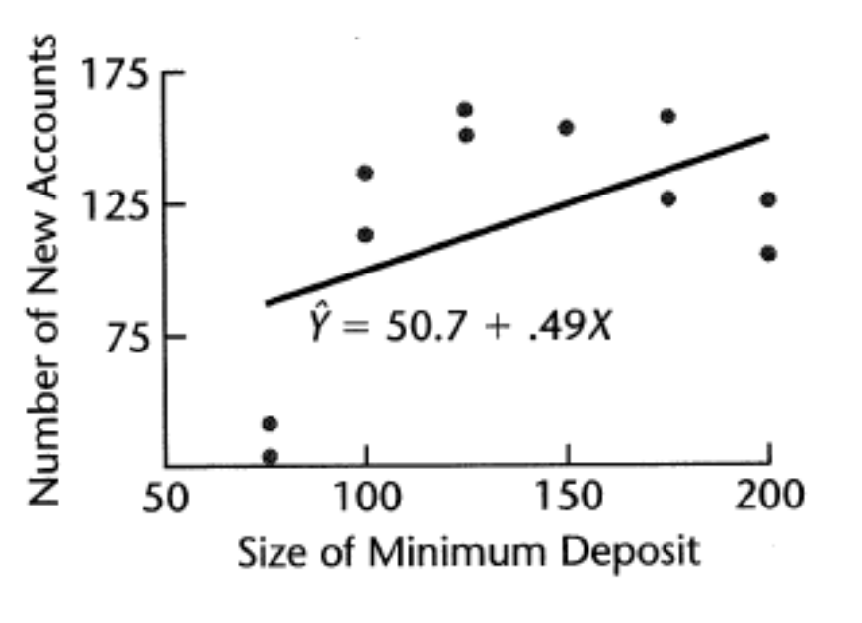
Fit

Slide 33
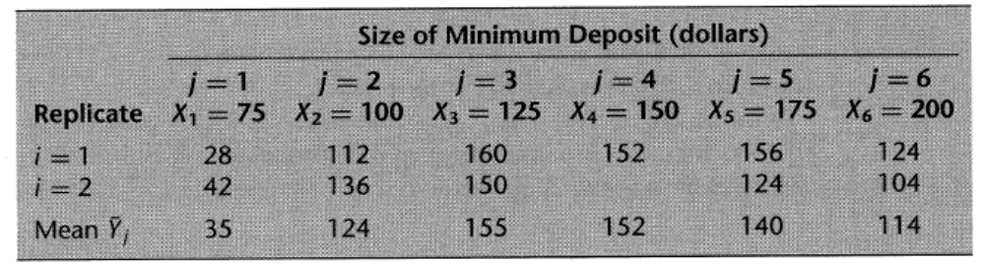
Data Arranged To Highlight Replicates
The observed value of the response variable for the i^{th} replicate for the j^{th} level of X is Y_{ij}.
The mean of the Y observations at the level X = X_{j} is Y_{j}

Slide 34
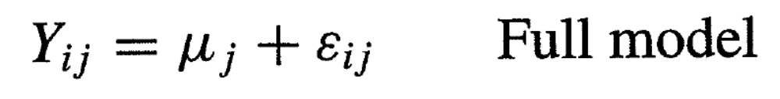
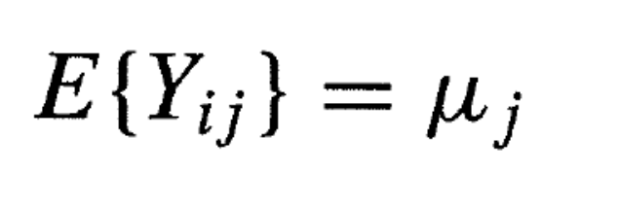
Full Model vs. Regression Model
The full model is
where
  ¹_{j} are parameters j = 1,…,c
  ²_{ij} are iid N(0,¾²)
Since the error terms have expectation zero

Slide 35
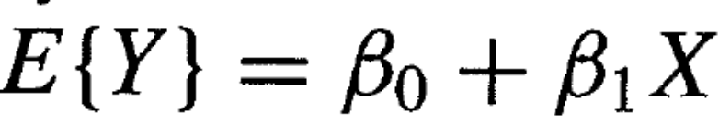
Full Model
In the full model there is a different mean (a free parameter) for each X_{i}
In the regression model the mean responses are constrained to lie on a line

Slide 36
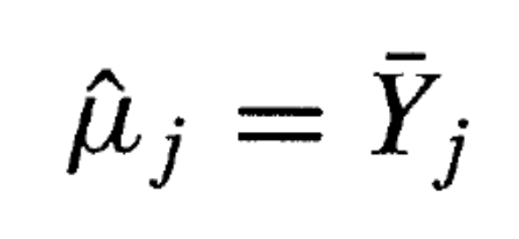
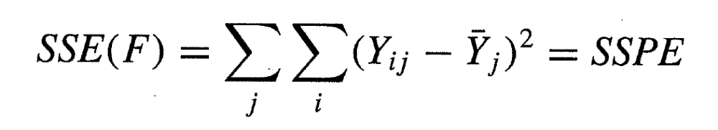
Fitting the Full Model
The estimators of ¹_{j} are simply
The error sum of squares for the full model therefore is

Slide 37
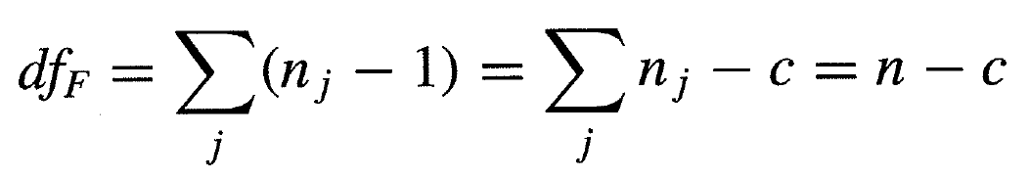
Degrees of Freedom
Ordinary total sum of squares has n-1 degrees of freedom.
Each of the j terms is a ordinary total sum of squares
  Each then has n_{j} -1 degrees of freedom
The number of degrees of freedom of SSPE is the sum of the component degrees of freedom

Slide 38
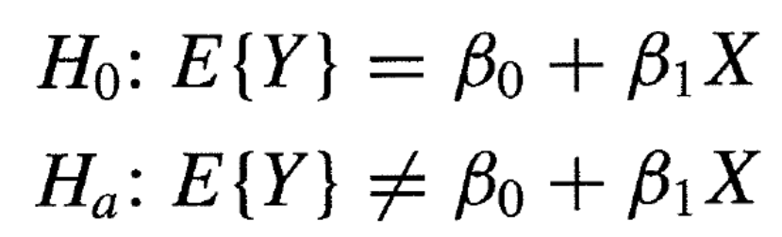
General Linear Test
Remember: the general linear test proposes a reduced model null hypothesis
  this will be our normal regression model
The full model will be as described (one independent mean for each level of X)

Slide 39
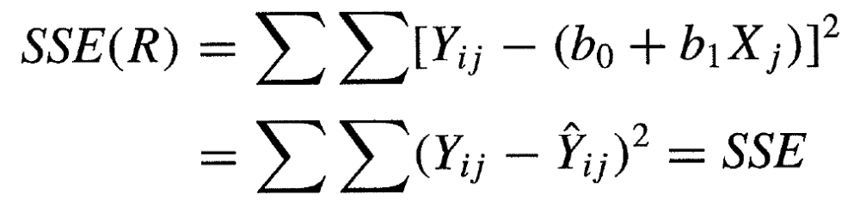
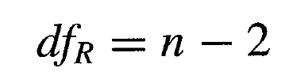
SSE For Reduced Model
The SSE for the reduced model is as before
  remember
  and has n-2 degrees of freedom

Slide 40
SSE(R)

Slide 41
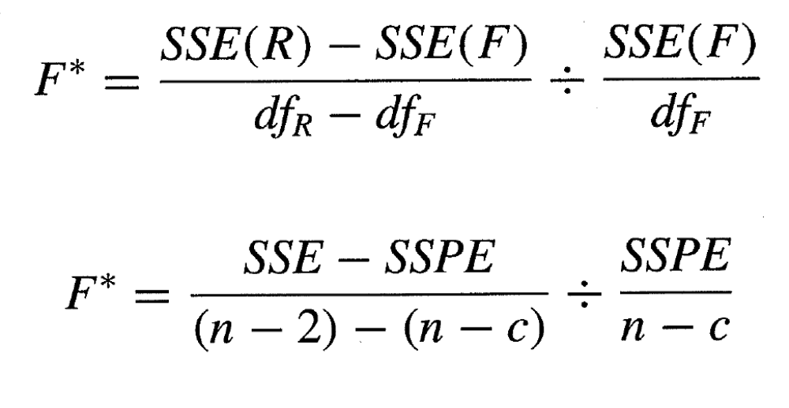
F Test Statistic
From the general linear test approach
a little algebra takes us to the next slide

Slide 42
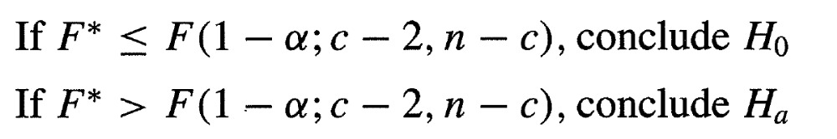
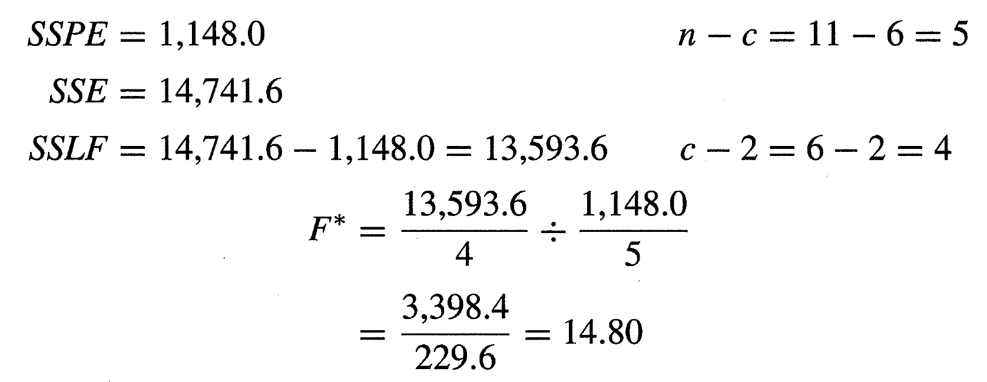
F Test Rule
From the F test we know that large values of F* lead us to reject the null hypothesis
For this example we have

Slide 43
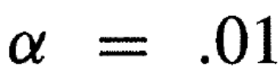

Example Conclusion
If we set the significance level to
And look up the value of the F inv-cdf
We can conclude that the null hypothesis should be rejected.

